Slide 1
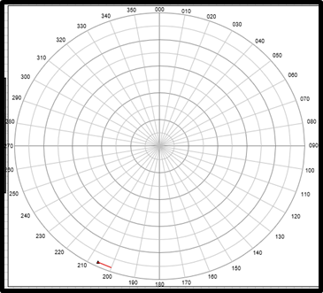
EMCON Plan is
ASMD Course of the Force
Active safety sectors
Watch Zones
ETA TDA
MPES
MPEV
PSR
TP. CF.
C. PROF.
OCT | AAW | ASuW | ASW | SC | SAU | SAG | WL | RV | BL | LT | PT | LY | CD | CO
AB/AV | AW/AC | AS/AT | AX/AY | AN/AD | CS | CG | L/17 | D/16 | B/15 | K/14 | P/11 | Y/7 | O/6 | C/5
ASMD
EJE | 1° | 2°
ALARMA – BASADO EN
ESTABLECER GRADO DE ALISTAMIENTO/ APROV.
ESTABLECER PLAN EMCON RADAR / RCF / SONAR
PUENTE VEL/RUMBO HELO ALER 15-5/ACCION EMER.
PRITAC
SITREP 1MC
PRIORIDAD DEL JEFE DE GDIA
ARMAS DE LA FZA
BUQUE
SM-1
NSSM
SEAWOLF
CHAFF C
HARPOON
TORPEDO
TIEMPO PERMANENCIA
FOCKER 60
B-200
TIEMPO ALCANCE ARMAS
A/N COMB.
INSTRUCCIONES
WARRNING | MAE SECTOR SEARCH
AAWO TOT | MAE PRF ALTA
EAM SCRAM | ACCION ETA TDA
RV. VUELO | POLITICA ZIGZAG
AERONAVES PROPIAS
Aeronave | HLO | Almas | Armas | Sono
TABLA TARGETING
IDENT. (H-S-F-N) | TRACK | RECON. | CERTEZA | T.A.A. |  | GREYHOUND
 |  |  |  | PEOR | ACTUAL | MFU | SALVO | I-TIME | DAMAS
PAPITAS
SITREP TACTICO
GOP/CALCULO SOA
RUMBO ASMD
ACCION SETEOS VAR.
ETA TDA
PUENTE VOLVER ESTACIONAMIENTO
MAE VERIF. PRF ALTA
ALERTA HELO
RV. VUELO
POLITICA ZIGZAG

Slide 2
MEZ: Oilfield / Kovold
Bruisers | _____° - sector____
Bulldogs | _____° - sector____
Ratfinks | _____° - sector____
Kilter | _____° - sector____
Autentication Policy | Bravo in force
Friendly assets
ASMD
EJE | 1° | 2° | EJE | 1° | 2°
0 | 50 | 310 | 180 | 230 | 130
10 | 60 | 320 | 190 | 240 | 140
20 | 70 | 330 | 200 | 250 | 150
30 | 80 | 340 | 210 | 260 | 160
40 | 90 | 350 | 220 | 270 | 170
50 | 100 | 0 | 230 | 280 | 180
60 | 110 | 10 | 240 | 290 | 190
70 | 120 | 20 | 250 | 300 | 200
80 | 130 | 30 | 260 | 310 | 210
90 | 140 | 40 | 270 | 320 | 220
100 | 150 | 50 | 280 | 330 | 230
110 | 160 | 60 | 290 | 340 | 240
120 | 170 | 70 | 300 | 350 | 250
130 | 180 | 80 | 310 | 0 | 260
140 | 190 | 90 | 320 | 10 | 270
150 | 200 | 100 | 330 | 20 | 280
160 | 210 | 110 | 340 | 30 | 290
170 | 220 | 120 | 350 | 40 | 300
EMCON Plan is
ASMD Course of the Force
Active safety sectors
Watch Zones
ASMD
EJE | 1° | 2°
RAP
DSI
TIEMPO PERMANENCIA
FOCKER 60
FOCKER 27
B-200
TIEMPO ALCANCE ARMAS
A/N COMB.
DISTANCIA AEROPUERT.
LA JOYA
SAN JUAN
B-200T | BEECHCRAFT | SEASPRAY 7300E
F-27 | FOKKER 27 | RDS-81 | LUCKY
F-60 | FOKKER 60 | APS-143B | OCEAN EYE
AERONAVES PROPIAS
Aeronave | HLO | Almas | Armas | Sono
COD. IFF
2000 | Vuelos visuals controlados
7000 | Vuelos visuals no controlados
7500 | Secuestro
7600 | Fallo de Comunicaciones
7700 | Emergencia
7720-7727 | SAR
T.A.A | 50 | 60 | 70 | 80 | 90 | 100 | 110 | 120 | 130 | 140 | 150 | 160 | 170 | 180 | 190 | 200
HELO | 00:11 | 00:16 | 00:21 | 00:26 | 00:31 | 00:36 | 00:41 | 00:46 | 00:51 | 00:56 | 01:01 | 01:06 | 01:11 | 01:16 | 01:21 | 01:26
FF NACIONAL PEORO CONDICION |  |  |  | 00:05 | 00:15 | 00:25 | 00:35 | 00:45 | 00:55 | 01:05 | 01:15 | 01:15 | 01:15 | 01:15 | 01:15 | 01:15
FF LUPO PEORO CONDICION |  |  |  |  |  | 00:03 | 00:13 | 00:23 | 00:33 | 00:43 | 00:53 | 01:03 | 01:13 | 01:23 | 01:33 | 01:43
SU. ET. | 2 | 3 | 4 | 5 | 6 | 8 | 9 | 10 | 11 | 12 | 14 | 15 | 16 | 17 | 18 | 20
SUKOI-25 | 2 | 4 | 5 | 7 | 9 | 11 | 12 | 14 | 16 | 17 | 19 | 21 | 23 | 24 | 26 | 28
ToT A/N | 5 | 6 | 7 | 8 | 9 | 10 | 11 | 12 | 13 | 14 | 15 | 16 | 17 | 18 | 19 | 20

Slide 3
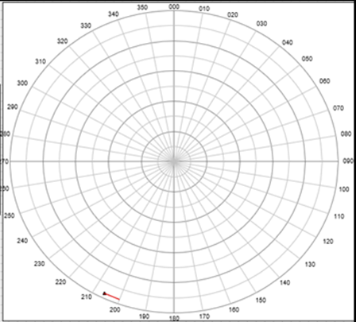
T.A.A | 50 | 60 | 70 | 80 | 90 | 100 | 110 | 120 | 130 | 140 | 150 | 160 | 170 | 180
HELO | 00:11 | 00:16 | 00:21 | 00:26 | 00:31 | 00:36 | 00:41 | 00:46 | 00:51 | 00:56 | 01:01 | 01:06 | 01:11 | 01:16
FF NACIONAL PEORO CONDICION |  |  |  | 00:05 | 00:15 | 00:25 | 00:35 | 00:45 | 00:55 | 01:05 | 01:15 | 01:15 | 01:15 | 01:15
FF LUPO PEORO CONDICION |  |  |  |  |  | 00:03 | 00:13 | 00:23 | 00:33 | 00:43 | 00:53 | 01:03 | 01:13 | 01:23
PR-72 | 00:28 | 00:38 | 00:48 | 00:58 | 01:08 | 01:18 | 01:28 | 01:38 | 01:48 | 01:58 | 02:08 | 02:18 | 02:28 | 02:38
MEKO 360 | 00:12 | 00:22 | 00:32 | 00:42 | 00:52 | 01:02 | 01:12 | 01:22 | 01:32 | 01:42 | 01:52 | 01:52 | 01:52 | 01:52
RV ASMD | 1° | 2°
DISTANCIA AEROPUERT.
LA JOYA
SAN JUAN
AERONAVES PROPIAS
Aeronave | HLO | Almas | Armas | Sono
 | 01 MISIL | 02 MISILES | 03 MISILES | 04 MISILES
20 | 4 | 6 | 8 | 10
30 | 5 | 7 | 9 | 11
40 | 7 | 9 | 11 | 13
50 | 8 | 10 | 12 | 14
55 | 8 | 10 | 12 | 14
60 | 9 | 11 | 13 | 15
65 | 9 | 11 | 13 | 15
70 | 10 | 12 | 14 | 16
75 | 11 | 13 | 15 | 17
CON WYPT
20 | 5 | 8 | 11 | 14
30 | 6 | 9 | 12 | 15
40 | 8 | 11 | 14 | 17
50 | 9 | 12 | 15 | 18
55 | 9 | 12 | 15 | 18
60 | 10 | 13 | 16 | 19
65 | 10 | 13 | 16 | 19
70 | 11 | 14 | 17 | 20
75 | 12 | 15 | 18 | 21
I-TIME
TIEMPO PERMANENCIA
FOCKER 60
FOCKER 27
B-200
TIEMPO ALCANCE ARMAS
A/N COMB.
GREYHOUND
A. | CLAS | B. MFU | C. TRU | D | E | F | SALVO | I-TIME
 |  |  |  | METH. B1 UNTILL REPORT FOR BULLD. | NEG | STD OFF - RISK L. - SALVO SIZE
BQ | INICIAL | LANZADAS
WL
PT
CD
CN

Slide 4
ASW

Slide 5
SITREP INICIAL & RUTINA
PRE-ATAQUE
ATAQUE
CHART CHECK +/-
POS/PROB SS/NO SS
BQ. DENTRO/FUERA TDA.
ETA TDA.
SUGIERO CLASIFICAR COMO ___
SSK POSI / DESCOLOCADO PARA
EFECTUAR ATAQUE SOBRE FUERZA
ESTABLECER ALARMA
EVADIR
TADPOLE
ATD/ATU/MARC.
PLAN R/N
MEDIOS AEREOS
SAC/SAU
SONAR A/P
WARNINGS/ROE’S
SUBOPAUTH
SSTW: W/Y/R
WCS: S/T/F
HUSH:
TADPOLE: 1/2/3/4/C
CO ASSESSMENT
1 SITUATION:
2 ASSES:
3 INTENT:
SSTW: W/Y/R
WCS: S/T/F
TADPOLE: 1/2/3/4/C
CO ASSESSMENT
I.- SITUATION:
DATUM _____ Active
PROB/POS____ in position____
C/S ____ as SAC.
Units inside TDA TANGO _____
II.- ASSES:
TACSIT: based on snooper ___ III.- INTENT:
C/S ____ Launch Cougar __
IOT ____
Form a SAU with:
Break, C/S__ C/S __ form a SAU IOT ____ ….over
CO ASSESSMENT
I.- SITUATION:
DATUM _____ Active
PROB/POS____ in position____
C/S ____ as SAC/SAUC
Units inside TDA TANGO _____
II.- ASSES:
TACSIT: based on snooper ___
III.- INTENT:
C/S ____ stay in ASW action until ____IOT ____
Main body intent ____
____ ….over
CHART CHECK
CAKE REPORT
TACSIT
(0): unknown
(1): TG located/ targeted
(2): TG located/disposition
(3): TG no located
209-1100/ 14 SST-4 / 28 MK-37 / CALYPSO II (I)
209-1200/ 14 SST-4 / 14 SUT-264 / 28 MK-37 / CALYPSO III (I)
209-1100/ 14 SST-4 / 28 MK-37 / CALYPSO III (I)
TR-1700/ 14 SST-4 / 44 MK-37 / CALYPSO IV (I)
 | C | O | Y | P | K | B | D | L
L
C
SITUACION
1) DATUM___, PROB___ AL
2) UNIDAD DENTRO/FUERA TDA
3) TMPO AL TDA
4) SSK posicionandose / descolocado para efectuar ataque sobre fuerza
SITREP TACTICO
ALARMA SUB: BL / AMA / ROJA
WEAPONS: SAFE / TIGTH / FREE
TADPOLE: 1/2/3/4/C
SITUACION:
APRECIACION:
INTENCIONES:
SUPERFICIE…
INTENCIONES
1) TADPOLE _____
2) ATAQUE URGENTE
3) ATAQUE DELIBERADO CON___
4) EVADIR CON RBO
5) ASUMIR COMO SAC
6) TP CONTRA FUEGO / PEDIR APOYO

Slide 6
OCT | AAW | ASuW | ASW | SC | SAU | SAG | WL | RV | BL | LT | PT | LY | CD | CO
AB/AV | AW/AC | AS/AT | AX/AY | AN/AD | CS | CG | L/17 | D/16 | B/15 | K/14 | P/11 | Y/7 | O/6 | C/5
ARMAS ANTI SUBMARINAS
UNIDAD | CAKE REP. |  | TORPEDOS LOSSE | FIRE TIME | EXP. TIME
 | L | C
 | /
 | /
 | /
 | /
 | /
 | /
 | /
 | /
DATUM
……… THIS IS ……
DATUM ….……ESTB.
IN POSITION …….....
DATUM ERROR ……
DATUM TIME ……...
TRACKING …………...
BASE ON ………………
CLASSIFIED……………
DATUM ……..., OVER
SETEOS ARMAMENTO
TORPEDO CONTRA FUEGO
BANDA | TUBO | ANGULO | PROFUND | MODO
EB
BB
CARGAS DE PROFUNDIDAD
CARGAS | PROFUNDIDAD |  | VELOCIDAD
1° CA.
2° CA.
DATOS BATIVELOSIGRAFOS
CAPA |  | MPES. | 16,5√CAPA (mts) 30√CAPA (pies) 200 pies + CAPA
MPES
MPEV
PSR |  | MPEV | 2/3 CAPA
TSR BQ.
TSR HELO
CODON EXECUTE PLAN BLACK/RED CORDON OVER……../DATUM….. IN POSITION ……..... SECTOR……..C/S…… SECTOR……..C/S…… RADIO OF SECT. ZERO……
DATUM
DATUM TN | CLASSIFFIED | DATUM TIME | CORDON EXP. TIME
8
1
7
2
6
3
5
4
DATOS TACTICOS
ALARMA
TADPOLE
ETA TDA
TCM EXP. TIME
FORCE EVACION COURSE
AERONAVES PROPIAS
AERONAVE | HLO | ALMAS | ARMAS | SONBY
SONOBOYAS
SONOBOYS | CANTIDAD | UTILIZADAS | DROP TIME | EXP. TIME
ACTIVAS
PASIBAS
BLACK OAKTREE
FORM Y. | COURSE | DIST. (X100 YDS) | SPEED | F. GOLF

Slide 7
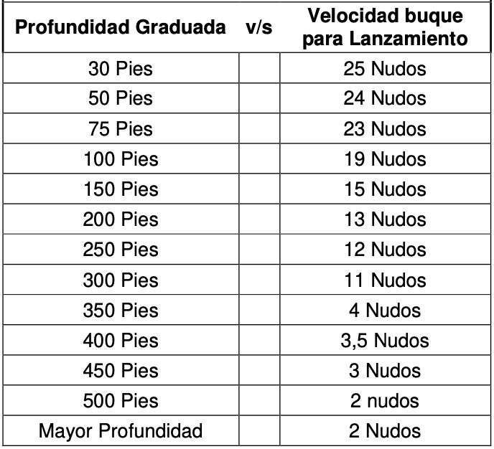
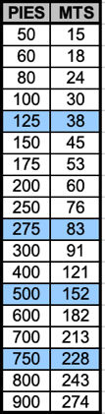
N° TK | POSICIÓN |  | TRAQUEO | EVAL
TIPO PULSO | CORTO | MEDIO | LARGO | MUY LARGO
CW | 150 MSEC | 300 MSEC | 600 MSEC
FM | 75 MSEC | 150 MSEC | 300 MSEC | 600 MSEC
INTERV TX | 4 KY | 8 KY | 12 KY | 16 KY | 24 KY | 32 KY
1
INFOTAC
HELO/BQ THIS IS __
RPORTING FOR INFOTAC METHOD __
STDBY MARK (LAT) - (LONG)
TRACKING ____ SPEED ____
2
1
2
POE SONAR
SONAR ACTIVO
MODO OPER CW/TB - CW/FM DM
MODO TX OMNI-DIR
PULSO
FREQ
EJE DE LA REBUSCA
RADAR VECTAC
HELO/BQ THIS IS ___
EX RADAR VECTAC
ASUM CLOSE POSITIVE CTRL
ASUM ANGLS (0,2) SPEED (80)
SELECT ONE BLOODHOUND/COBRA
SETTINGS___
2 MILES TO RUN, CHK SETTING CHK SWITCHES
1 MILE TO RUN, CHK HEIGHT CHK SPEED
HALF MILE TO RUN, STDBY TO DROP
STDBY, DROP! NOW NOW NOW!
LOOSE ADVISORY, INVESTIGATE
DGBOX STABLISH IN POS (GPS)
DGBOX EXPIRY TIME ____
POE TORPEDO
PWO: ACCIÓN TP. PROBSUB___ 1 TP BANDA __
ACC: ACCIÓN TP PROBSUB___ 1 TP BANDA __
SELECTAR RUBO N° __ DE LA BANDA DE __
ÁNGULO DE GIRO (0/35/70) – +-(45/80/105)
PROF. INICIAL (125/275/500/750/1000)
MEJOR RUMBO
PWO: APRUEBO PARÁMETROS
ACC: TP LISTO
PWO: UN TP POR LA BANDA DE __ DISPARAR
ACC: FUEGO TP, SONAR BAJA POTENCIA, PARTIDA DE REAPROVISIONAMIENTO MÓVIL UN TP POR LA BANDA DE __ RECARGAR
W THIS IS _ ONE COBRA LOOSE, DOGBOX STABLISH XXX° _ RANGE XX, DOGBOX EXPIRY TIME HH:MM
CHARCHECK
CHTCHECK FINALIZADO, CHTCHEK NEG/POS
BUQUE DENTRO/FUERA TDA
CALCULANDO TIEMPO AL TDA
MEJOR RUMBO EVASIÓN_____
SUGIERO:
CLASIFICAR COMO _____ (ESPERAR CLASIFICACIÓN DE__)
ALARMA _____
TADPOLE_____
MARCADO PREV / ATQUE URG / ATQUE DELIB
ASUMIR SAC (ESPERAR QUE __ ASUMA COMO SAC), PWO

