Slide 1
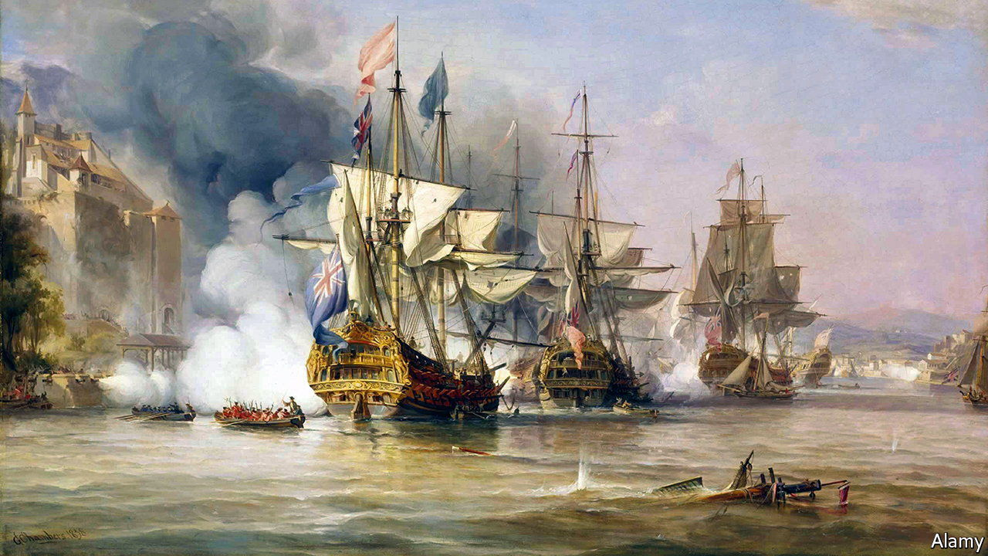
War of Jenkins ´ eAR
CADETES: Hidenobu Tsukame y Tomás Vega
CURSO: 3°B
AÑO: 2025

Slide 2
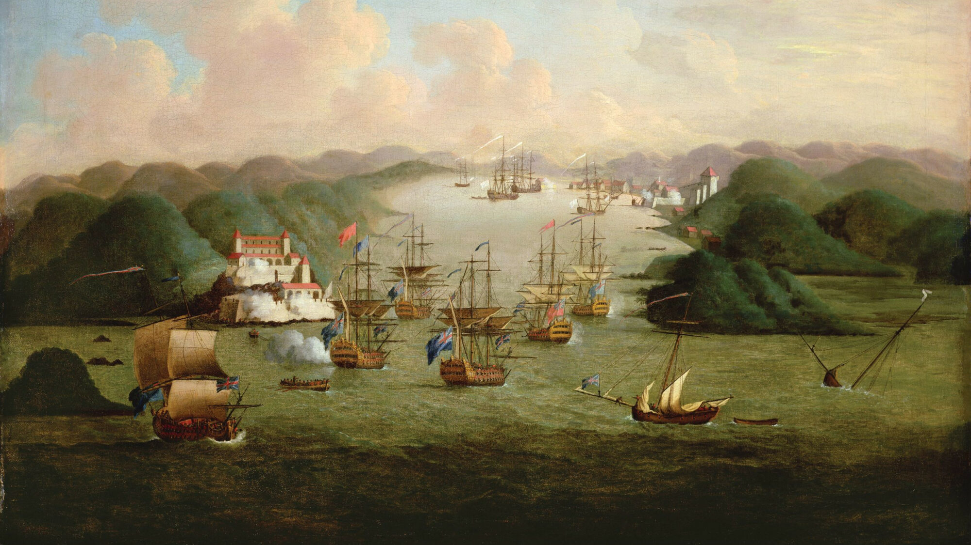




introduction
Brief context: The War of Jenkins’ Ear (1739-1748) was a conflict between Great Britain and Spain over trade rights in the Caribbean and the Americas.
Key players: Spain (King Philip V) vs. Britain (King George II).
Main objective: Britain wanted to expand its trade influence in the Americas.

Slide 3
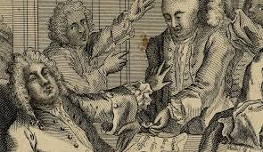
Causes
British merchants wanted to expand trade in Spanish-controlled territories.
Spain enforced strict trade laws (asiento system).
The incident of Jenkins’ Ear (1731) as a pretext for war.

Slide 4
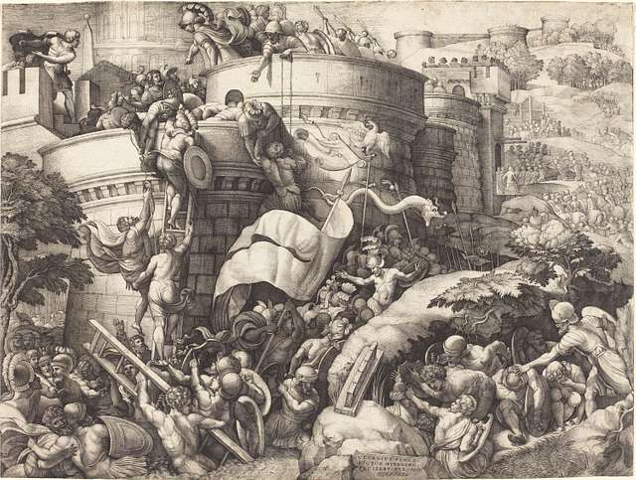


FIrst attack TO” La Guaira”
Admiral Edward Vernon led the attack on this Venezuelan port.
Spanish forces, led by governor Gabriel de Zuloaga, successfully defended the city.
Heavy British losses due to strong fortifications and Spanish resistance

Slide 5
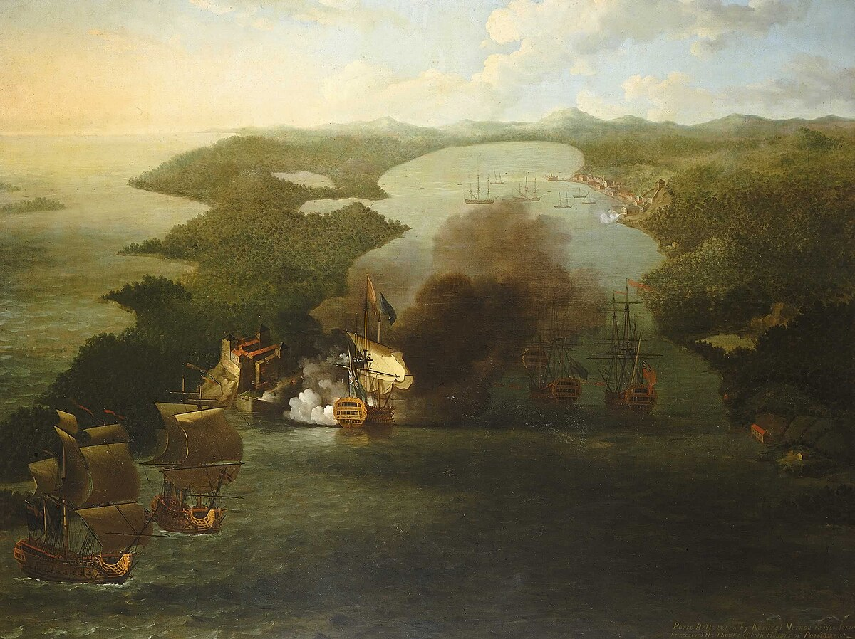
First attack to Porto Belo
Successful British attack led by Admiral Vernon.
The fort was destroyed, dealing a significant blow to Spanish trade.
Victory used for British propaganda (Porto Bello Road in London named after it).

Slide 6
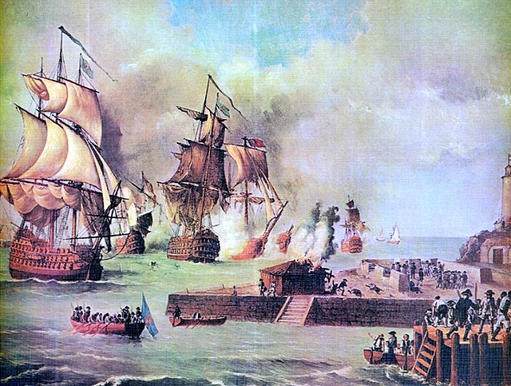
First attack to ´´Cartagena de indias´´
Failed initial attempt by the British navy.
Strong Spanish fortifications and tropical diseases weakened the British forces.

Slide 7
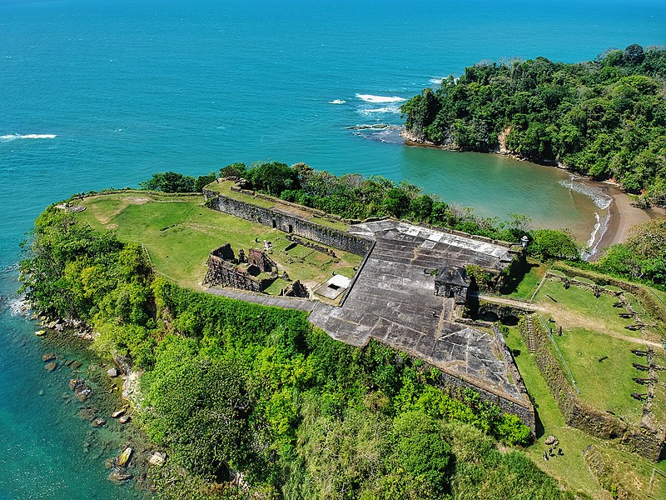
Destruction of San Lorenzo Fortress
British forces attacked and destroyed this Spanish fortress in Panama.
It was a key fort protecting the route to the Pacific and silver shipments.

Slide 8
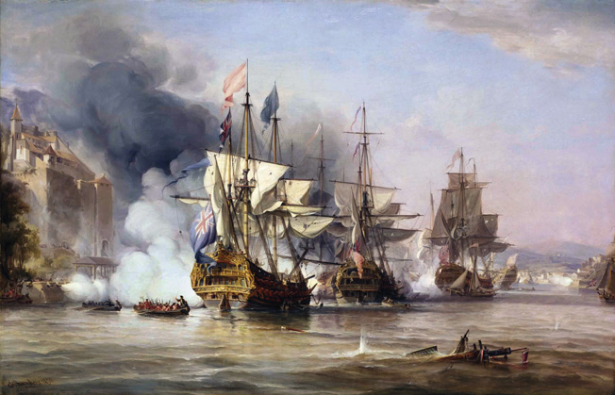
The Battle of Cartagena de Indias
Largest battle of the war; decisive Spanish victory.
Admiral Vernon led a massive fleet of over 180 ships and 27,000 men.
Spanish defense led by Blas de Lezo, who used smart tactics and the city’s fortifications.
Disease (yellow fever) devastated the British troops, forcing them to retreat.

Slide 9
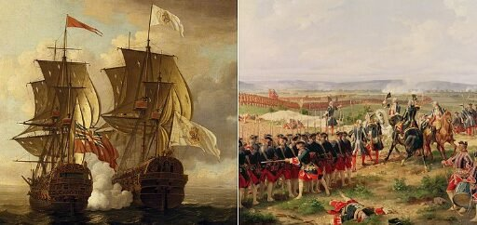
consequences
Britain failed to expand its trade influence in Spanish America.
Spain strengthened its defenses in the Caribbean.
The war merged into the War of Austrian Succession.
Treaty of Aix-la-Chapelle (1748) ended the war; no major territorial changes.

Slide 10
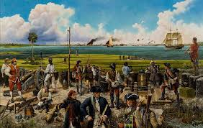
Conclusion
The war showed Spain’s resilience in defending its territories.
Britain underestimated the Spanish and the tropical conditions.
The conflict was costly and inconclusive, with no major changes in colonial power.

Slide 11
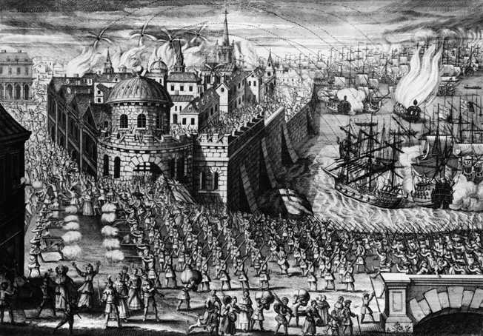
END

