Slide 1




CÁTEDRA DE INGLÉS
How to...
PEC
Pearson English Connect
Tutorial Step by Step

Slide 2



Do you have a Pearson account?
If not, here’s how to make it

Slide 3

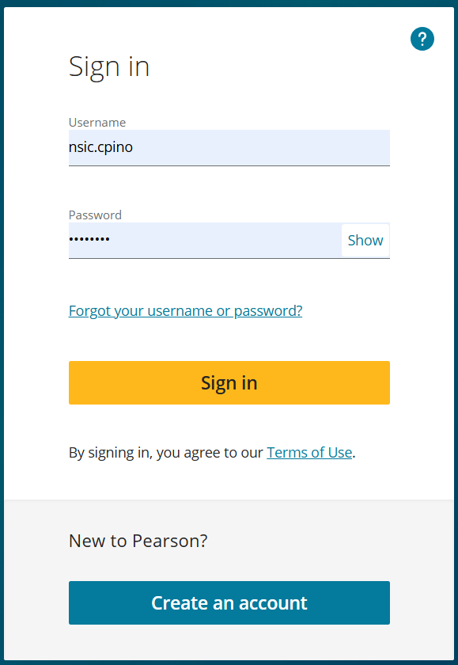


Step 1 :
You need a mail
Type Pearson Sign-in in your Browser

Slide 4
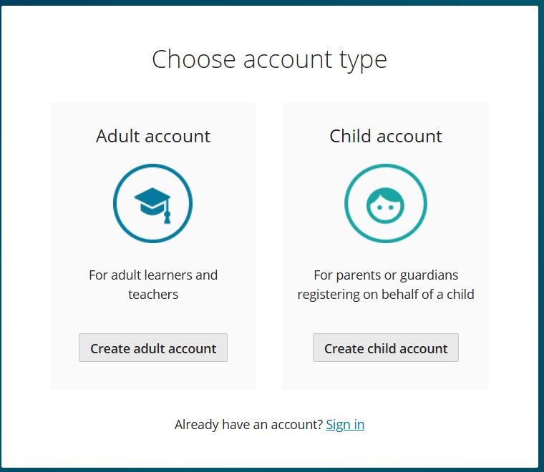


Step 2: Choose the Adult acc.

Slide 5
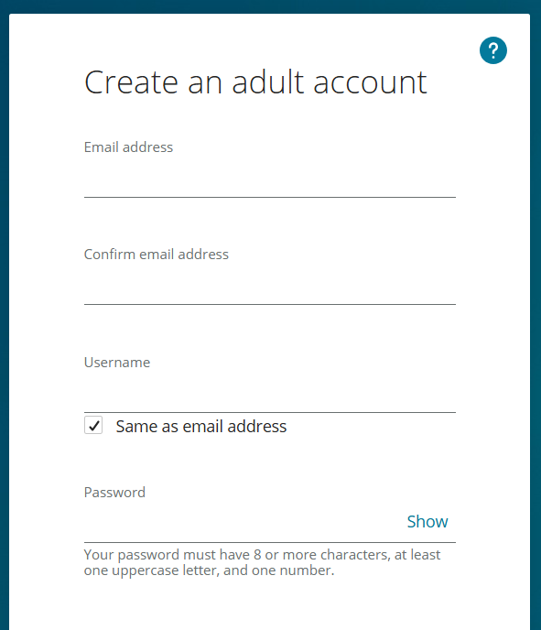

Step 3 : Follow the steps
tulio.triviño@gmail.com
tulio.triviño@gmail.com
tulio.deusc1
Triviño7

Slide 6
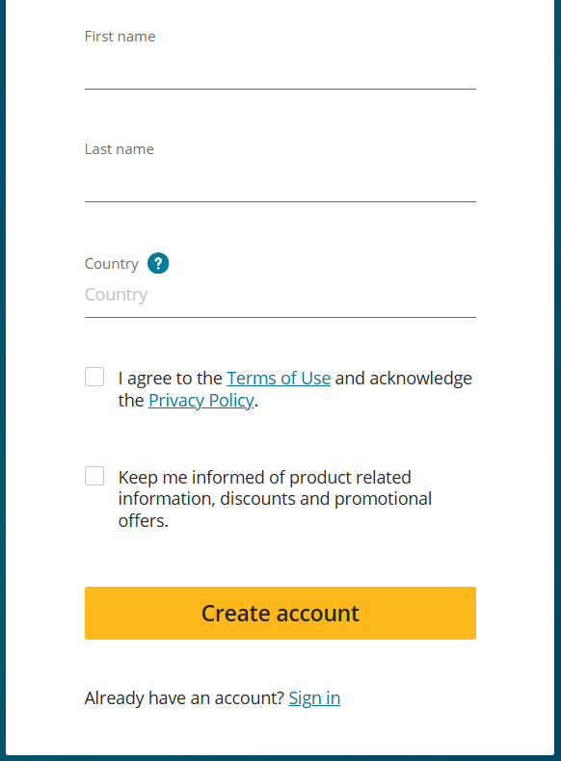


Tulio
Step 3 : Follow the steps
Triviño
Chile

Slide 7

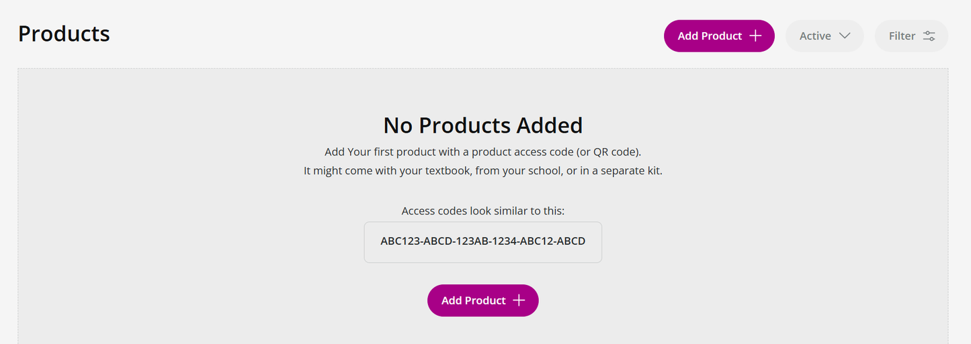

Step 4 : Add your product
You’ll see this:

Slide 8

Step 4 : Add your product
Click here

Slide 9
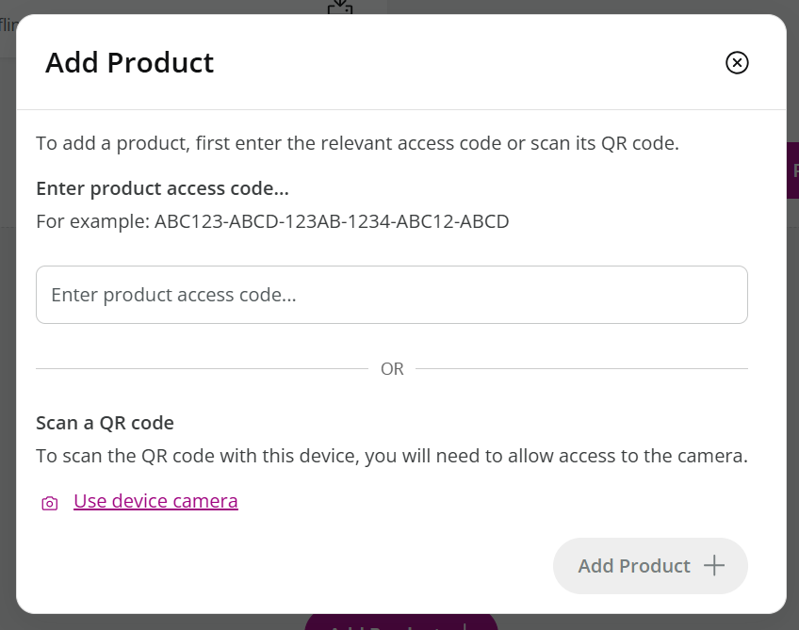


Step 4 : Add your product
Find the code in your book

Slide 10
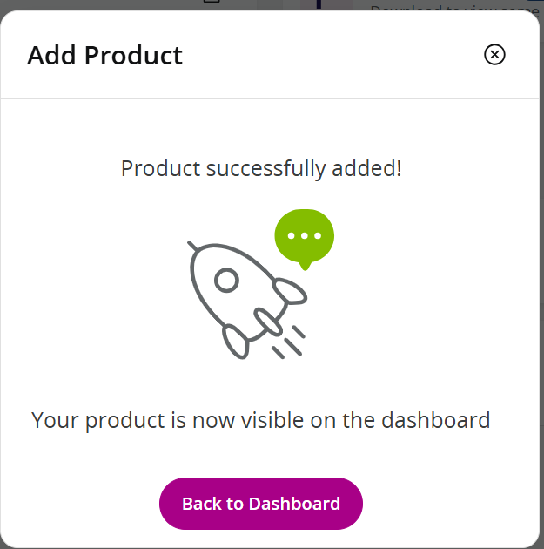
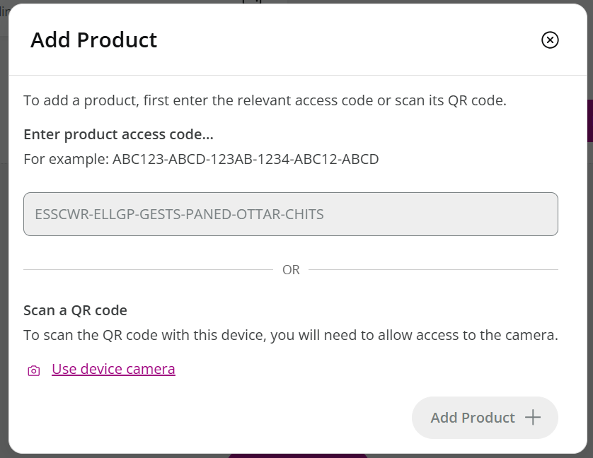
Step 4 : Add your product
DONE!
WRITE IT

Slide 11
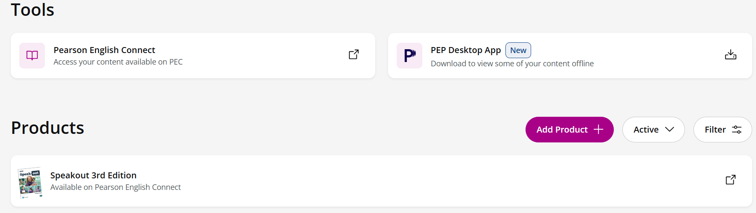
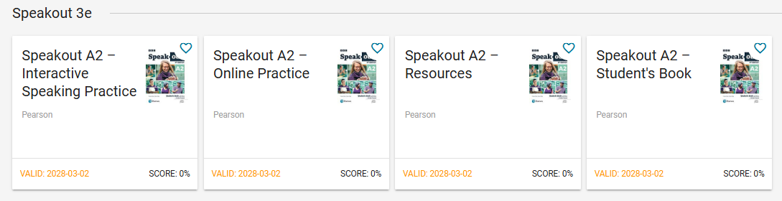

Now it will appear here:
CLICK HERE AND YOU’LL SEE THE PRODUCTS

Slide 12
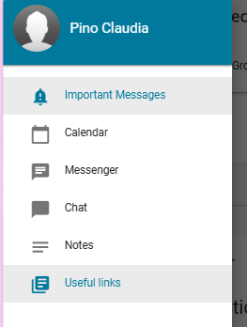

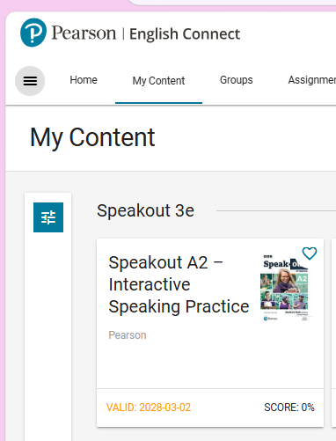


Step 5 : INSTALL THE APP
Click the menu

Slide 13
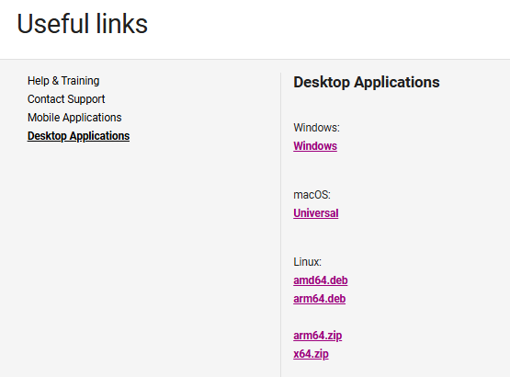
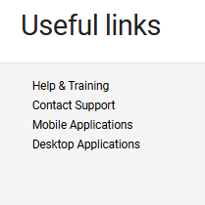
Step 5: INSTALL THE APP

Slide 14

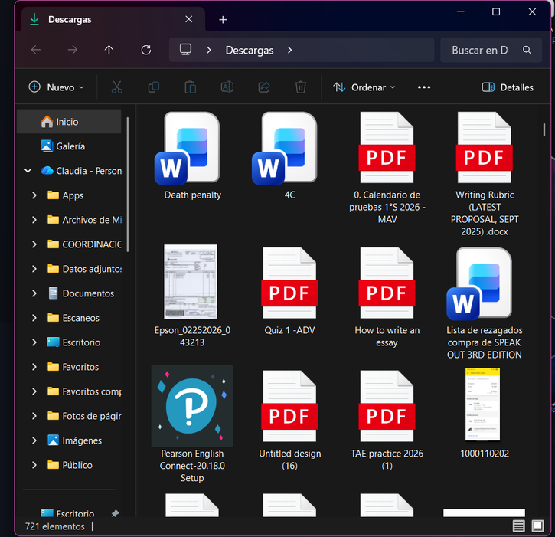


Step 6: Install it
Step 7: Log-in

Slide 15
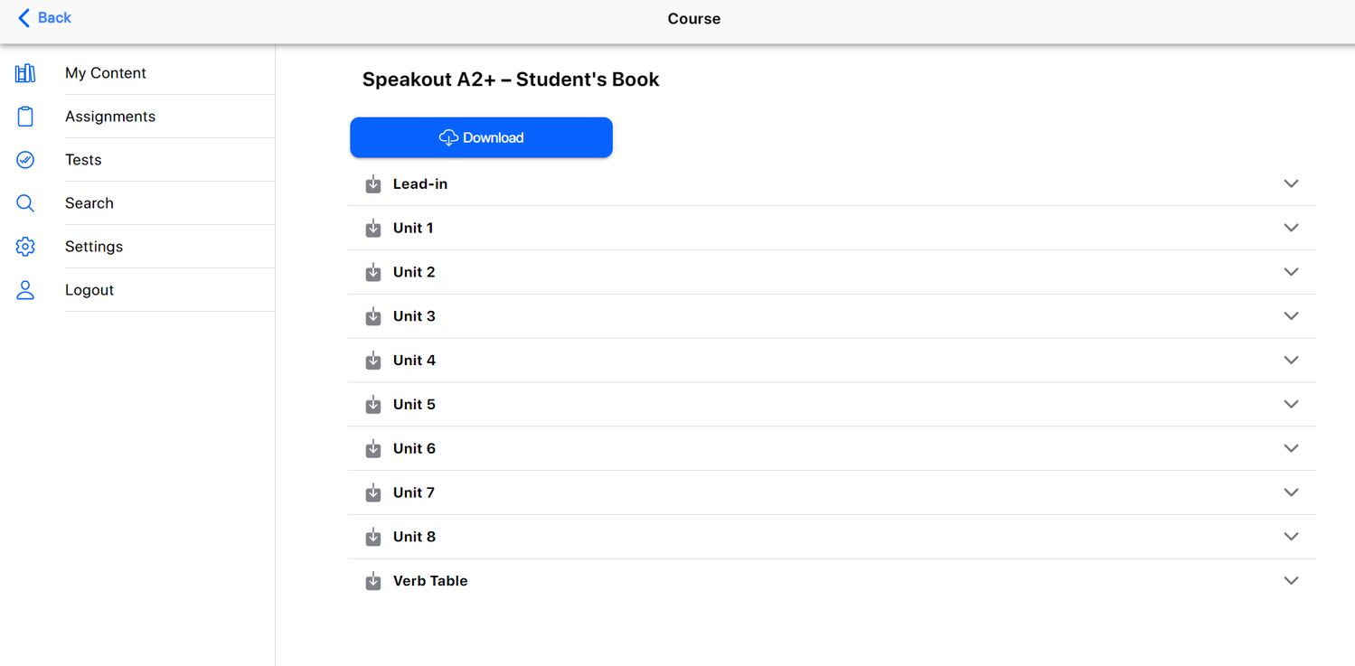
Step 7: Download the material

Slide 16
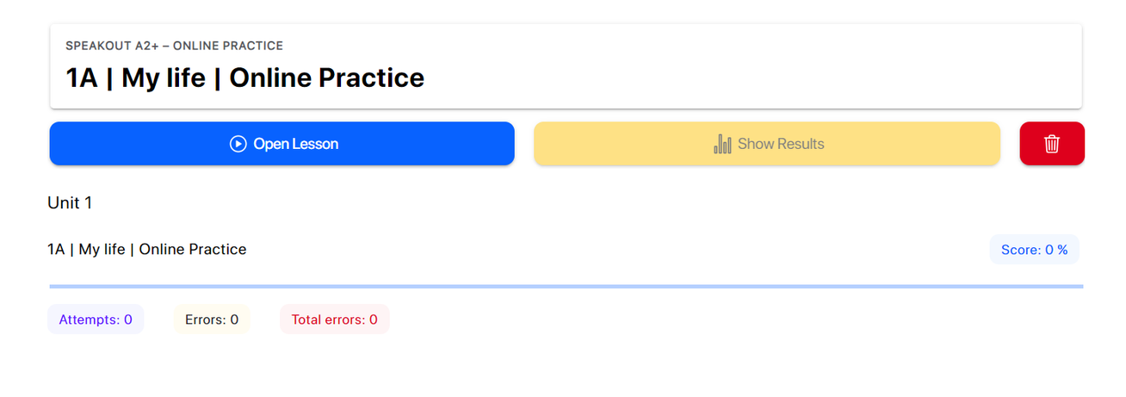
Step 7: Download the material
Step 8: Practice!

Slide 17




Thank You

