Slide 1
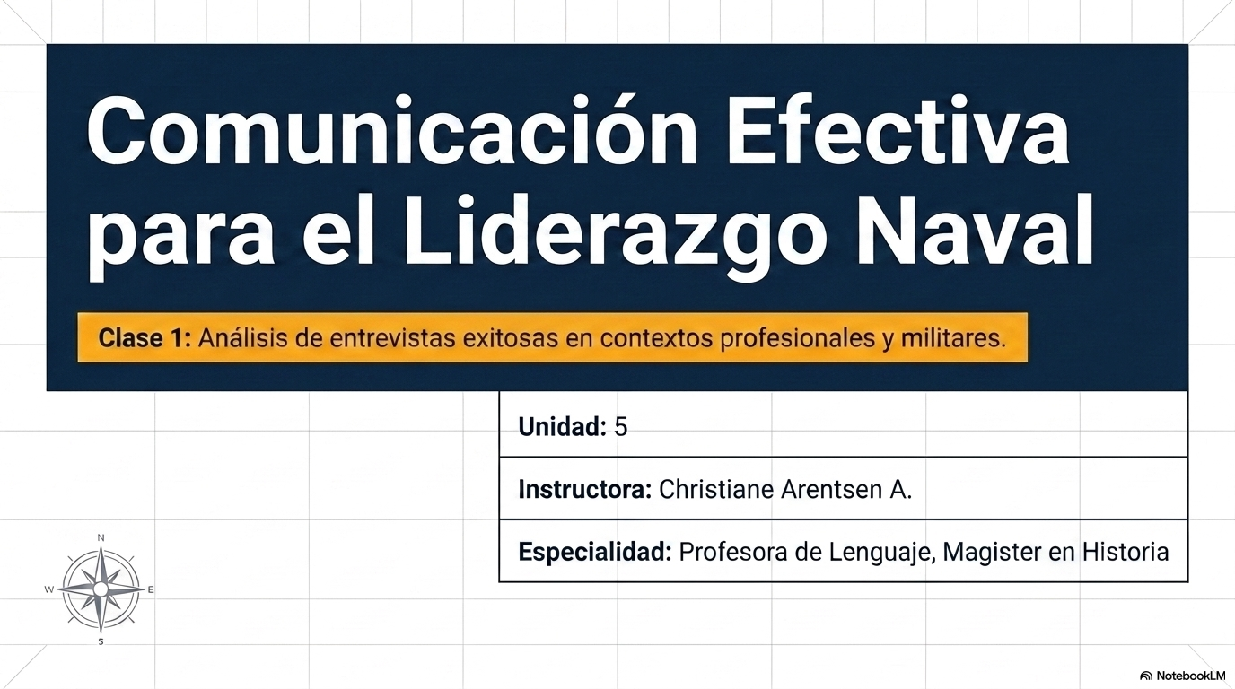

Slide 2
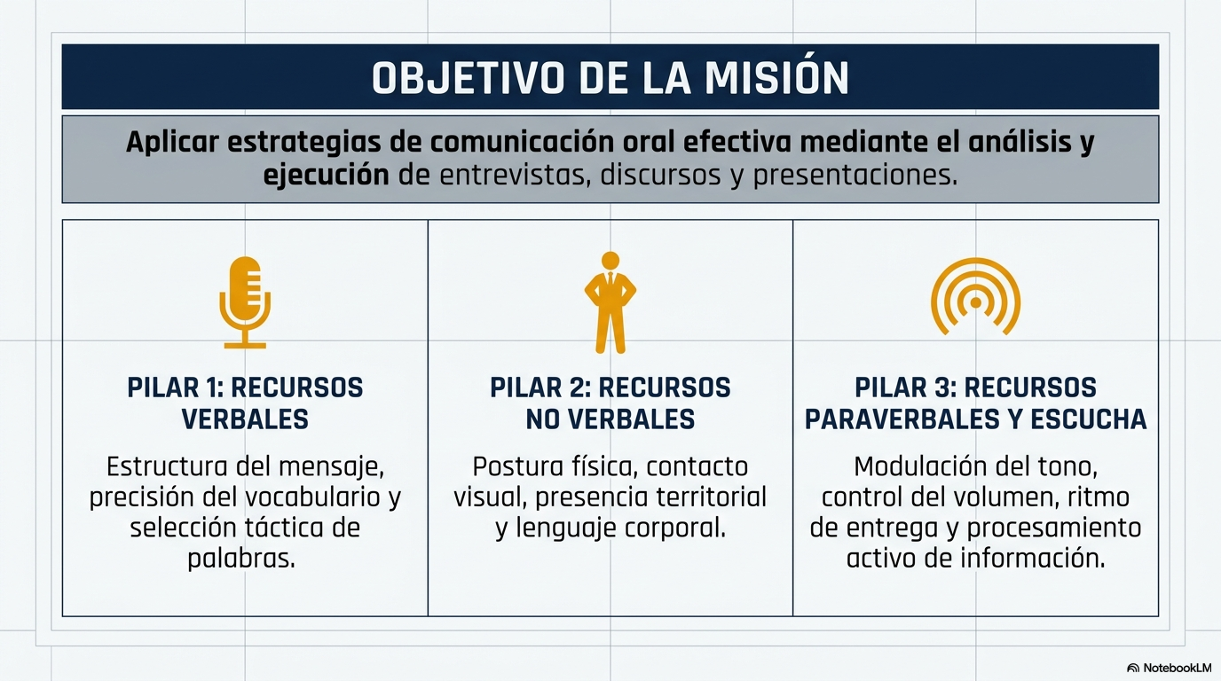

Slide 3
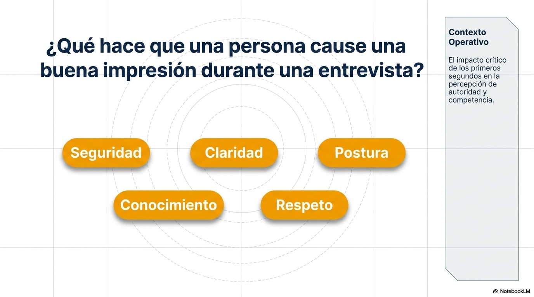

Slide 4
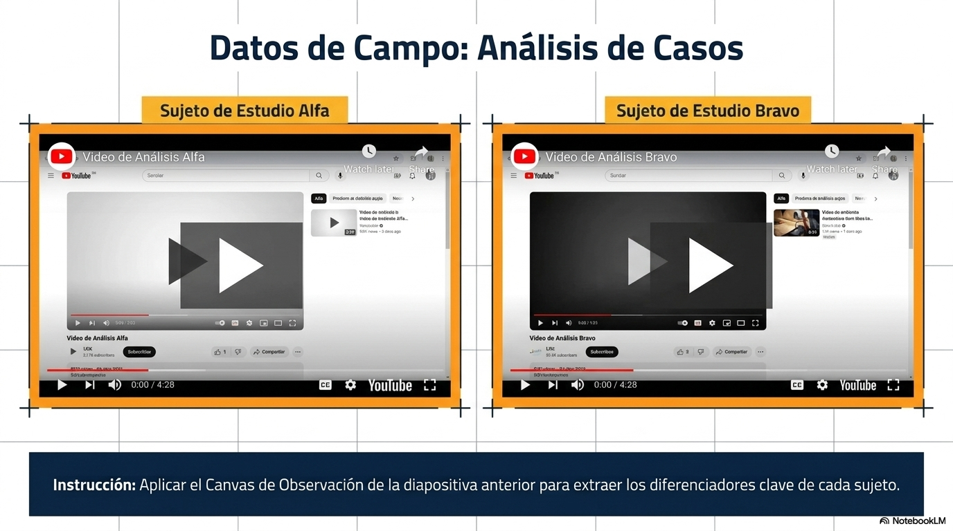
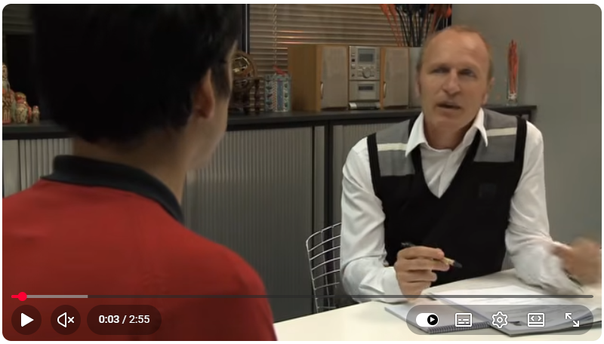
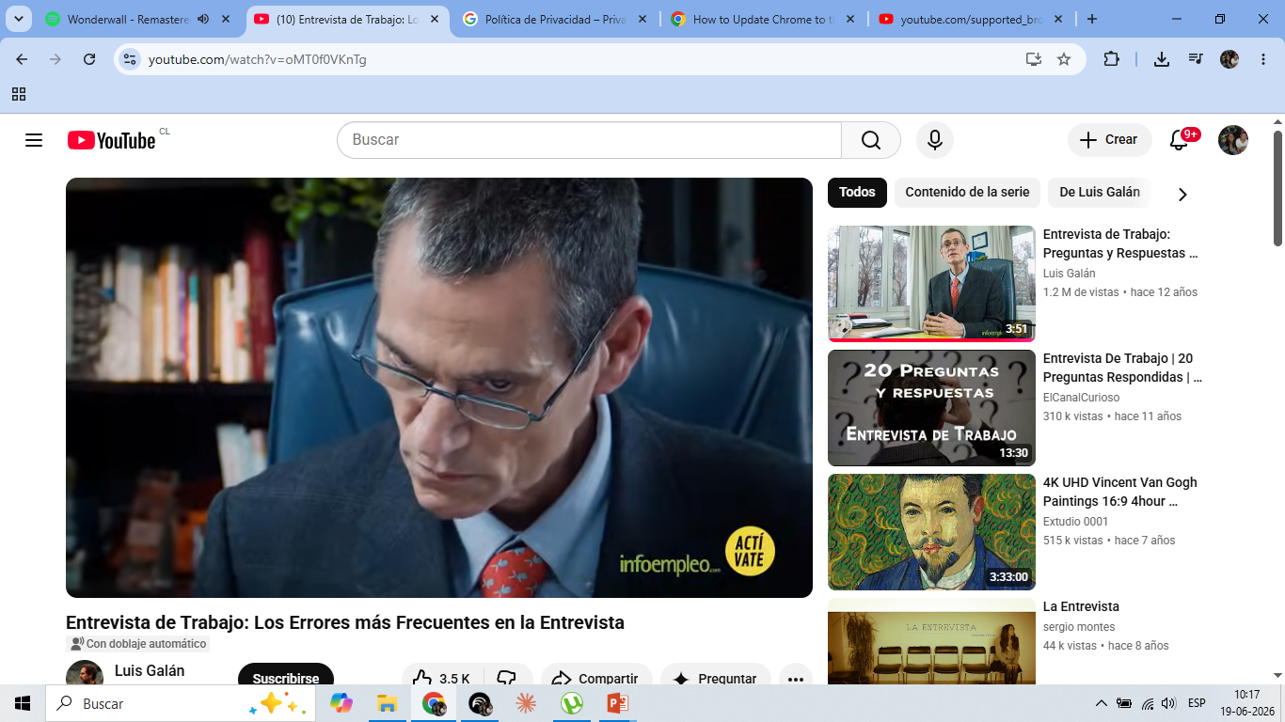
https://youtu.be/NTKWgQuVfyQ?si=FteJi42ufKz_Hqtf
https://youtu.be/oMT0f0VKnTg?si=WyKwHb-3nFqsyonE

Slide 5
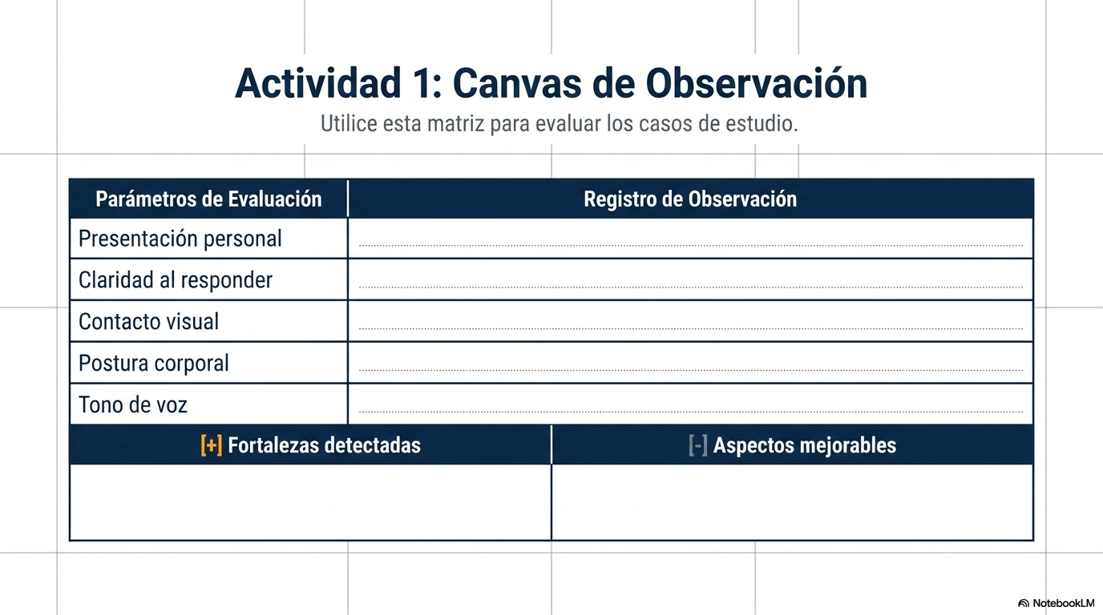

Slide 6
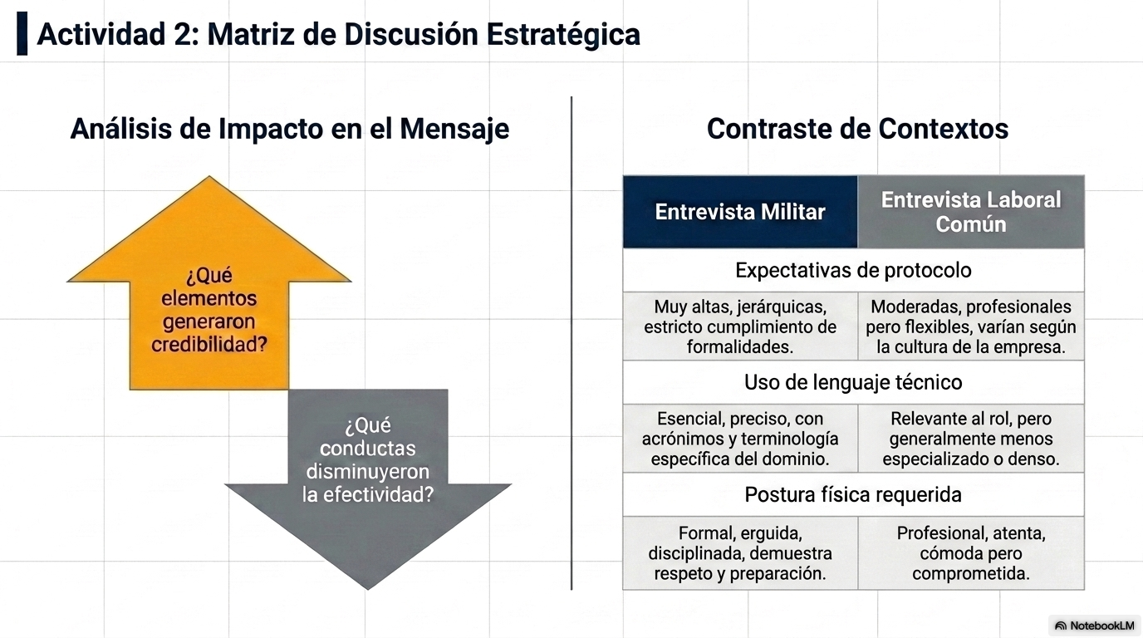

Slide 7


